Slide 1

ANDROID APP TO CONNECT FARMER TO CUSTOMERS
PRENSTED BY
Shubham Hiraman Bharambe(200105121028)
Harshal Ulhas Thorat(200105121024)
Hritvik Ramashankar Gupta(200105121023)
Pranav Ravindra Nakil (210105122003)
Under the Guidance of
Prof. Prafulla Chaudhari
(Associate Professor)

Slide 2
Table of Contents
Introduction.
Objectives.
Rationale: Justification, why needed?
Features (Intended Towards the Farmer)
Feasibility Study.
Methodology.
Facilities Required For Proposed Work.
Expected Outcomes.
Conclusion.

Slide 3
Introduction
There’s a lot to think about when it comes to marketing agricultural products.
Farm direct marketing is a long felt need of the farmers and consumers of the country as it goes a long way in ensuring higher remuneration to the farmers and meeting the satisfaction level of the consumers through direct sale of the agricultural commodity by the farmers to the consumer at affordable prices. Direct marketing of agricultural produce helps in complete elimination of middle men and commission agents who charge high level of commission fee from the agriculturists/farmers coming to the market yards for selling their product and then artificially inflate the retail prices.
What farmers need to consider when selecting which direct marketing channels fit best with a farm’s resources, goals and accessible customer base.

Slide 4
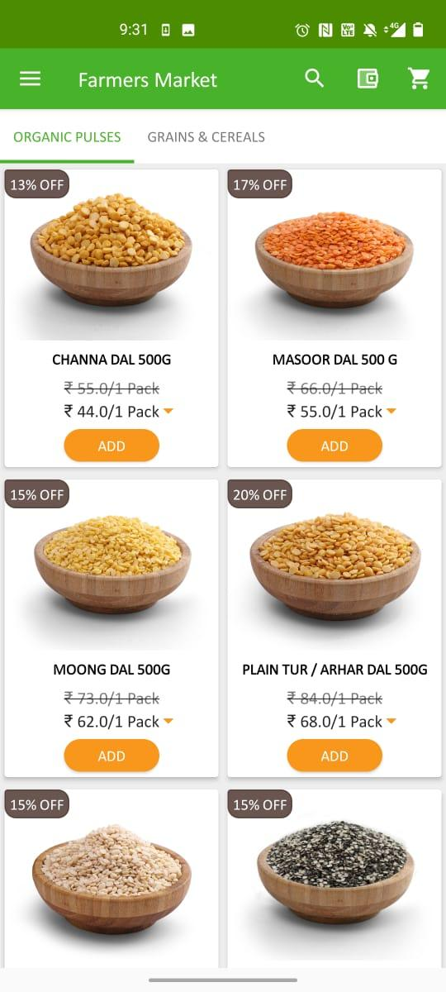
Objectives
The objective of this application is to allow farmers to sell their products directly to merchants, without having to go through any intermediaries. This will allow them to get better prices for their products, and will also allow merchants to get better quality products at a lower price. The application will allow farmers to list their products for sale, and will allow merchants to browse through these listings and make offers on the products they are interested in. Once an offer is made, the farmer will be able to accept or reject it. If the farmer accepts the offer, the merchant will be able to pick up the product from the farmer's location. The application will also allow farmers to track the status of their products, and will allow merchants to track the status of their orders.
The aim of this project is to develop an Android application that can be used by farmers to sell their produce directly to merchants. The application will allow farmers to list their products and prices, and merchants will be able to browse and purchase items from farmers. The application will also provide a messaging system so that farmers and merchants can communicate with each other.

Slide 5
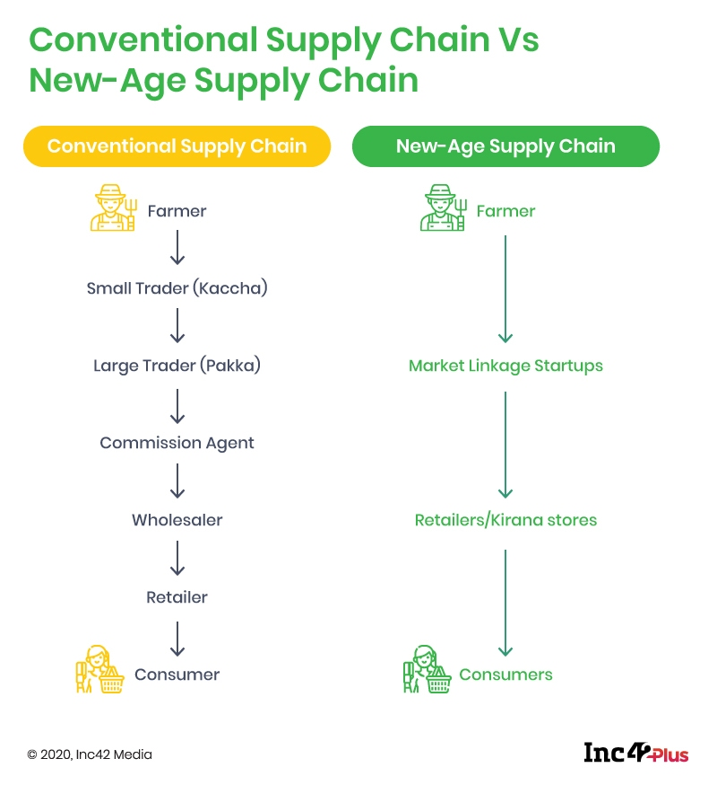
Rationale: Justification, why needed?
The main thing is that the farmer grows but cannot sell it, before entering the direct market There is a chain of brokers So, his goods get low price, vegetable store also cannot be possible. Then the market booms or busts at that time, climate change and many more to face.
The application would allow farmers to sell their produce directly to merchants, without having to go through intermediaries. This would allow farmers to get better prices for their goods, and would allow merchants to get fresher goods at lower prices. This would benefit both farmers and merchants, and would likely increase the overall efficiency of the agricultural market.

Slide 6
Features (Intended Towards the Farmer)
FEATURES:
Easy to use-This system is very user-friendly and allows any updating quickly through the customized menu and also reduces time.
Time-Saving- This system saves a lot of time of farmer instead of they are going to market in that they are doing auction and decision making.
New-age Technology- This project uses new age technology like in Cloud technology services like Amazon Web Service it depends on the large amount of Data.
Decision Making- Design Making is Easy when it comes with Tech there are the actual need of the farmer.
Quick Registration- Download the app, register using google account or manually (Username, password, email, phone number).
The app would need to allow farmers to list their products and allow customers to browse and search for what they need.
There would need to be a way for customers to pay for products, and for farmers to receive payment.
The app would need to track inventory, so that farmers know what they have available to sell, and customers know what is available to buy.
The app would need to provide customer service, so that customers can get help if they have questions or problems.

Slide 7
Feasibility Study
Required Feasibilities For Project:
The feasibility study of an android agricultural application should include an analysis of the needs of the farmers, the android operating system, and the development environment.
Economical Feasibility.
Technical Feasibility.
Operational Feasibility.
Marketing Feasibility.

Slide 8
Methodology
A. Overview Technology
We are all familiar with mobile phones these days, with their potential to link people, as well as their usefulness and flexibility, which makes life easier in any new location. In the corner, user pleasure is the most important factor to consider. As a result, we had to design a project that best suited the surroundings and used well-known and simple-to-use technologies.
B. About Android
Android is the popular smartphone OS in the world. Our product was built on the Android platform, which is open source. We chose Android because we are developing a mobile app and it is well known that Android is the popular smartphone OS worldwide. Android's best feature is its graphical user interface. On-screen elements are controlled via touch controls that loosely simulate real-world movements such as swiping, tapping, as well as a virtual keyboard, in the default user interface for Android. The device is designed to respond to human input instantly, with a fluid touch interface that frequently employs the smartphone's vibrating capabilities to provide hepatic feedback to the user.

Slide 9
Methodology
Application Framework
By providing an open development environment, Android allows developers to create highly complex and distinctive applications. The framework APIs are the same as those used by the core apps are available to developers. Any application can publish its capabilities, which can later be used by other apps, thanks to the application architecture (security constraints enforced by the framework). Components can be changed by the user using the same technique.

Slide 10
Methodology
All apps are supported by a variety of services and systems, including:
Lists, grids, text boxes, buttons, and even an embeddable web browser are among the Views that may be used to develop an application.
Applications can use Content Providers to obtain data from other apps (such as Contacts) or to provide their own data.
A Resource Manager allows you access to non-code resources such as translated text, images, and layout files.
All apps may show personalized notifications in the status bar thanks to a Notification Manager.
An activity manager that governs the lifecycle of program and a universal navigation back stack.

Slide 11
Methodology
About MySQL
Modern websites appear to be increasingly reliant on complicated databases. These databases keep all their vital data and, in some situations, makes it easy to maintain. The Structured Query Language (SQL) is a widely used DB language, for data storage, updating, and retrieval a breeze. MySQL is most powerful SQL servers available, and it's also completely free. MySQL has a number of features, including: Handles big databases with over 50 million records. There are no memory leaks. A safe and versatile privilege and is password secured that supports host-based verification. Passwords make the connection secured because the connection is encrypted.

Slide 12
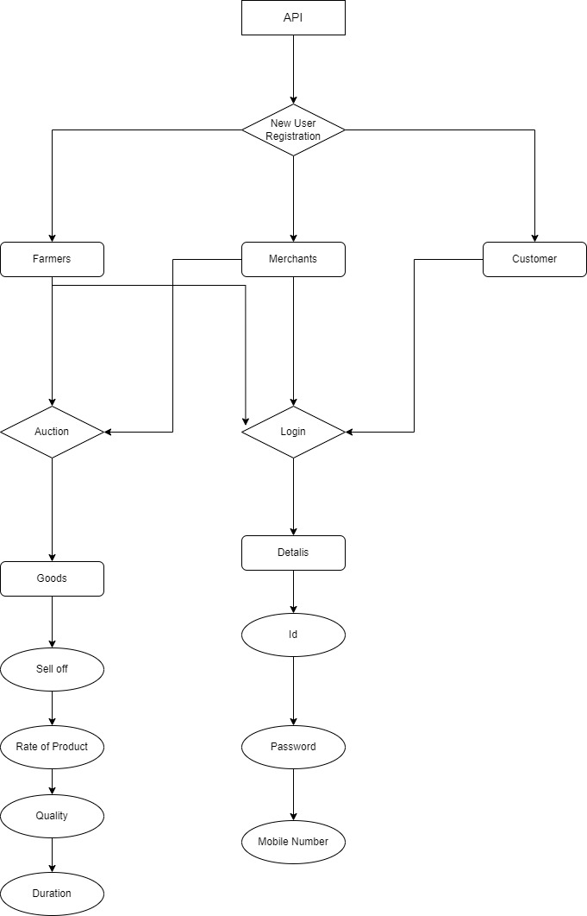
Methodology

Slide 13
Facilities required for proposed work
Hardware Requirements:
Software Requirements:
Processor | Intel Core i5 8th Generation
RAM | 8 GB Dual Channel 3200Mhz DDR4
Operating System | Windows 10 Professional
Storage | 1 TB Hard drive
Programming Language | Java
Programming Language Version | Java 8
Integrated Development Environment (IDE) | Android Studio, JDE
Database Server | MySql
Cloud Platform | Amazon Web Services (AWS)

Slide 14
Expected outcomes
expected outcomes about building an android application with the intention of direct chain of farmers and merchants.
The direct chain of farmers and merchants would be able to sell their products directly to consumers through the android application. This would allow for a more efficient and cost-effective way of selling goods.
In our application farmers are selling their goods directly to the merchants
actually, what could happen is there is a plot in some specific village
As many plots as there are in it.
A merchant visits him and only then do you know what the process is your motive is to get that man better value to their goods than the fake market.
There is a actual interaction between the farmer and Marchant

Slide 15
Conclusion
It is possible to build an Android application that would enable direct communication between farmers and merchants. However, such an application would require a significant amount of development work and would need to be carefully designed to ensure that it is user-friendly and easy to use. Furthermore, it is important to consider the potential security risks associated with any direct communication between farmers and merchants.

Slide 16
THANK YOU

